Slide 1
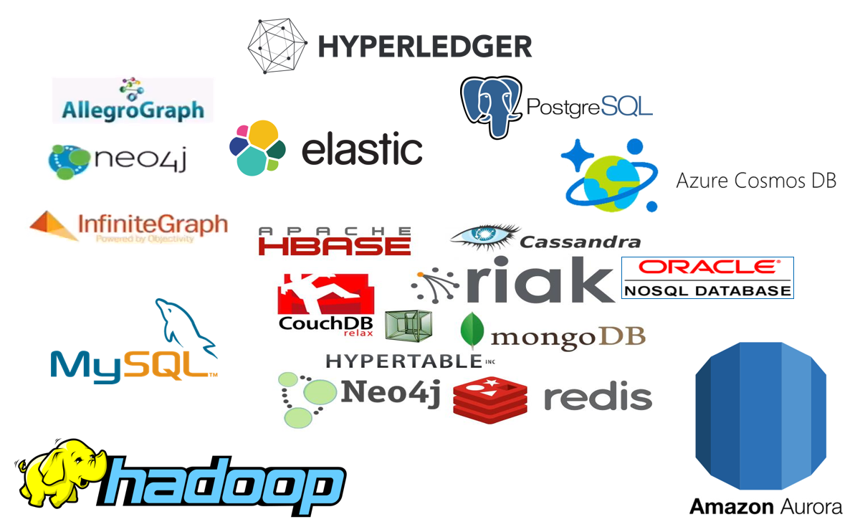





50 Shades of Data how, when and why Big, Fast, Relational, NoSQL, Elastic, Event, CQRS
On the many types of data, data stores and data usages
µ
µ
Lucas Jellema, CTO of AMIS
CodeOne 2018, San Francisco, USA
Notes:
Fast data arrives in real time and potentially high volume. Rapid processing, filtering and aggregation is required to ensure timely reaction and actual information in user interfaces. Doing so is a challenge, make this happen in a scalable and reliable fashion is even more interesting. This session introduces Apache Kafka as the scalable event bus that takes care of the events as they flow in and Kafka Streams and KSQL for the streaming analytics. Both Java and Node applications are demonstrated that interact with Kafka and leverage Server Sent Events and WebSocket channels to update the Web UI in real time. User activity performed by the audience in the Web UI is processed by the Kafka powered back end and results in live updates on all clients.
Fast data arrives in real time and potentially high volume. Rapid processing, filtering and aggregation is required to ensure timely reaction and actual information in user interfaces. Doing so is a challenge, make this happen in a scalable and reliable fashion is even more interesting. This session introduces Apache Kafka as the scalable event bus that takes care of the events as they flow in and Kafka Streams for the streaming analytics. Both Java and Node applications are demonstrated that interact with Kafka and leverage Server Sent Events and WebSocket channels to update the Web UI in real time. User activity performed by the audience in the Web UI is processed by the Kafka powered back end and results in live updates on all clients. Introducing the challenge: fast data, scalable and decoupled event handling, streaming analytics Introduction of Kafka demo of Producing to and consuming from Kafka in Java and Nodejs clients Intro Kafka Stream API for streaming analytics Demo streaming analytics from java client Intro of web ui: HTML 5, WebSocket channel and SSE listener Demo of Push from server to Web UI - in general End to end flow: - IFTTT picks up Tweets and pushed them to an API that hands them to Kafka Topic. - The Java application Consumes these events, performs Streaming Analytics (grouped by hashtag and author and time window) and counts them; the aggregation results are produced to Kafka - The NodeJS application consumes these aggregation results and pushes them to Web UI - The WebUI displays the selected Tweets along with the aggregation results - in the Web UI, users can LIKE and RATE the tweets; each like or rating is sent to the server and produced to Kafka; these events are processed too through Stream Analytics and result in updated Like counts and Average Rating results; these are then pushed to all clients; this means that the audience can Tweet, see the tweet appear in the web ui on their own device, rate & like and see the ratings and like count update in real time

Slide 2




Lucas Jellema Architect / Developer 1994 started in IT at Oracle 2002 joined AMIS Currently CTO & Solution Architect

Slide 3
Overview
Multiple types of data
Stored and processed in different ways
Same data sometimes used in multiple, different ways
Stored and processed multiple times – optimized for each use case
The meaning of some terms cannot be taken too literally
Real Time and Fresh
Integrity and Truth
Consistency and transactions
Understand your data
Meta: What does it mean?
Master: Where is the source?

Slide 4
Tweet! #codeone

Slide 5
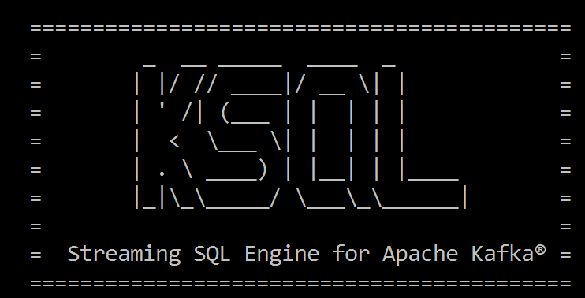
Select from <stream of tweet events>
select text , author , timestamp
from tweets
Where tag = 'codeone'
<--- streaming data

Slide 6
Select Running Count from <stream of tweet events>
select tag
, count(*) tweet_count from tweets
group by tag

Slide 7
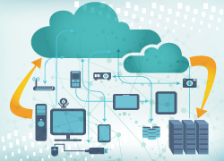
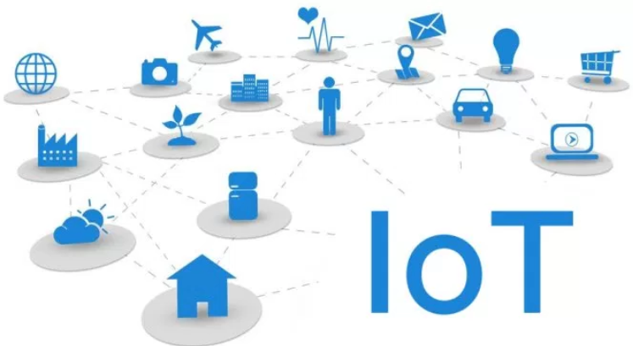

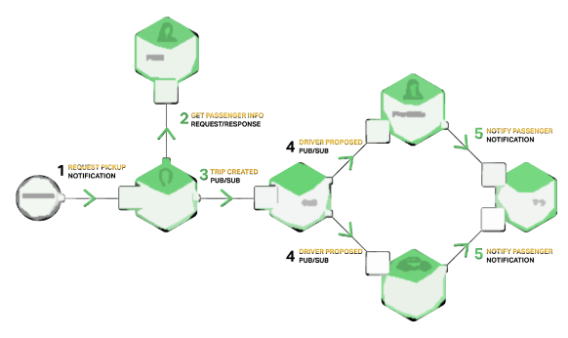













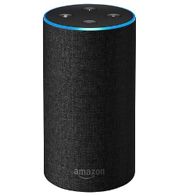
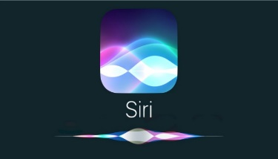

Oracle Cloud
Tweets on #JEEConf #java #oraclecode
IoT metrics from hundreds of devices
User actions & click events from webshop
Live Traffic Events
Microservices chatter
Social Media events (Facebook, Whatsapp, …)
IT Operations – monitoring metrics
Application Container
Event Hub
Tweets
Topic
Client
Client
Client
Client
Running Tweets Aggregation
SSE
µ
TWEET_COUNT Topic
µ
µ
µ

Slide 8
Oracle Cloud
Tweets on #JEEConf #java #oraclecode
IoT metrics from hundreds of devices
User actions & click events from webshop
Live Traffic Events
Microservices chatter
Social Media events (Facebook, Whatsapp, …)
IT Operations – monitoring metrics
Application Container
Event Hub
Tweets
Topic
Client
Client
Client
Client
Running Tweets Aggregation
SSE
µ
TWEET_COUNT Topic
µ
µ
µ

Slide 9
Real Time live | fresh | instantaneous | on line | synchronous

Slide 10


Slide 11


Slide 12


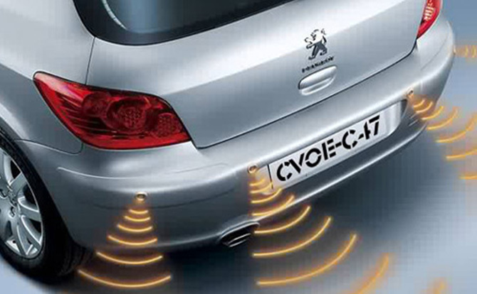


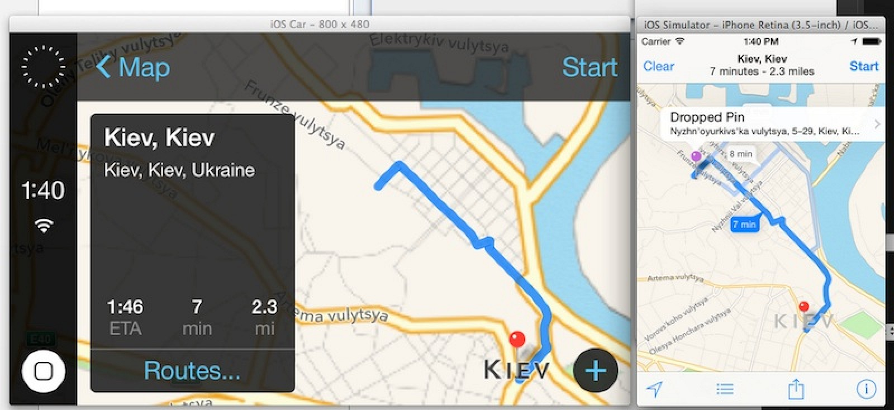
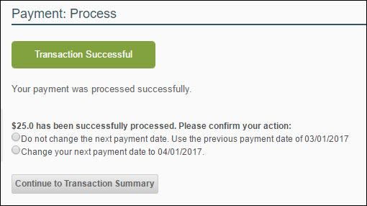
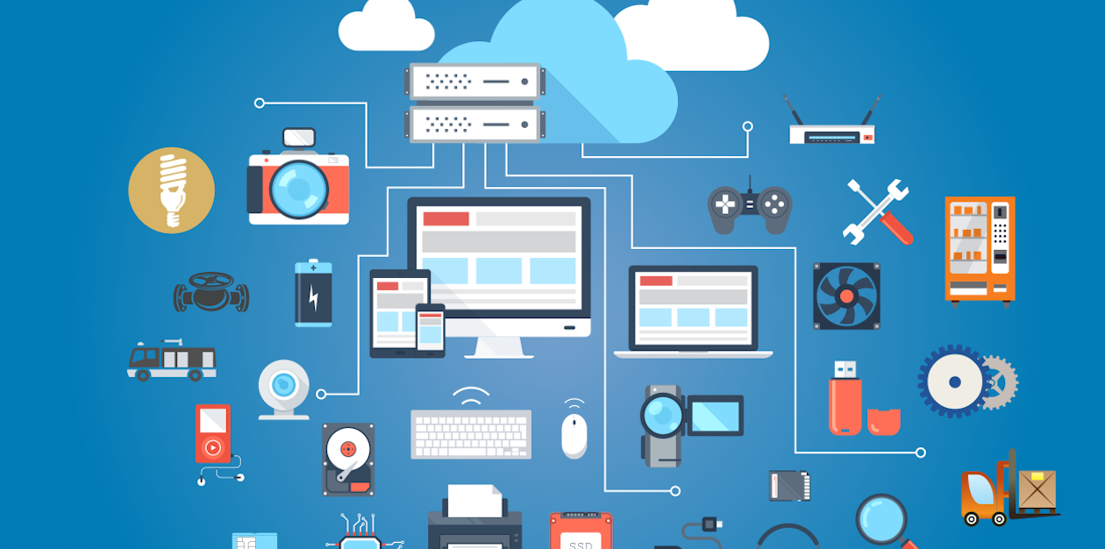

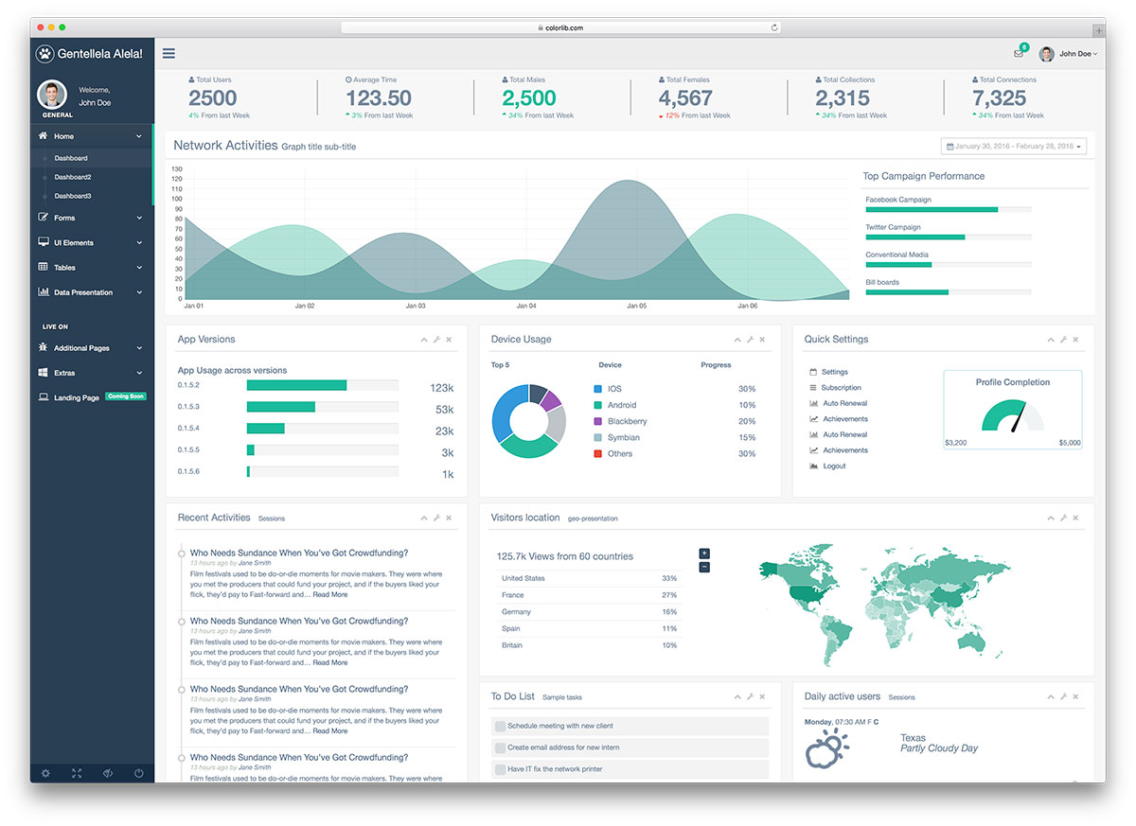

Slide 13


Slide 14

< 10 ms
< 100 ms
< 500 ms
<3 secs
> 3 secs
Machine Response
Human Reaction
14

Slide 15

< 10 ms
< 100 ms
< 500 ms
<3 secs
> 3 secs
Machine Response
Human Reaction
15

Slide 16

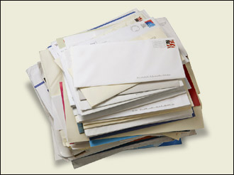

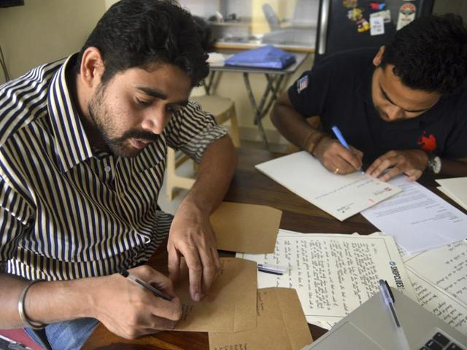
Quest for fresh data
2 min
36 hr
10 min
BPM Engine
Processing cases for Customers
2%
1 min
48 hr
Background Batch Process
(preparing letters for customers)
Customers
2 wk

Slide 17

Integrity
Madelon’s pasje
Real world vs World of Databases
Relax!
Anomaly detection

Slide 18

Data Constraints to protect integrity
Allowable values
Mandatory attributes
(Foreign Key) References
NULL
Constraints on
type
length
format
Spelling
Character encoding
Notes:
https://specify.io/concepts/microservices

Slide 19


Data is representation of the known real world
How useful is it to enforce data integrity?
Notes:
https://specify.io/concepts/microservices

Slide 20

Data Integrity
Why?
Is it about truth?
About regulations and by-the-book?
Allow IT systems to run smoothly and not get confused?
About auditability and non-repudiation?
What about the real world?
Data in IT is just a representation; if the world is not by the book – what should IT do?
Notes:
https://specify.io/concepts/microservices

Slide 21
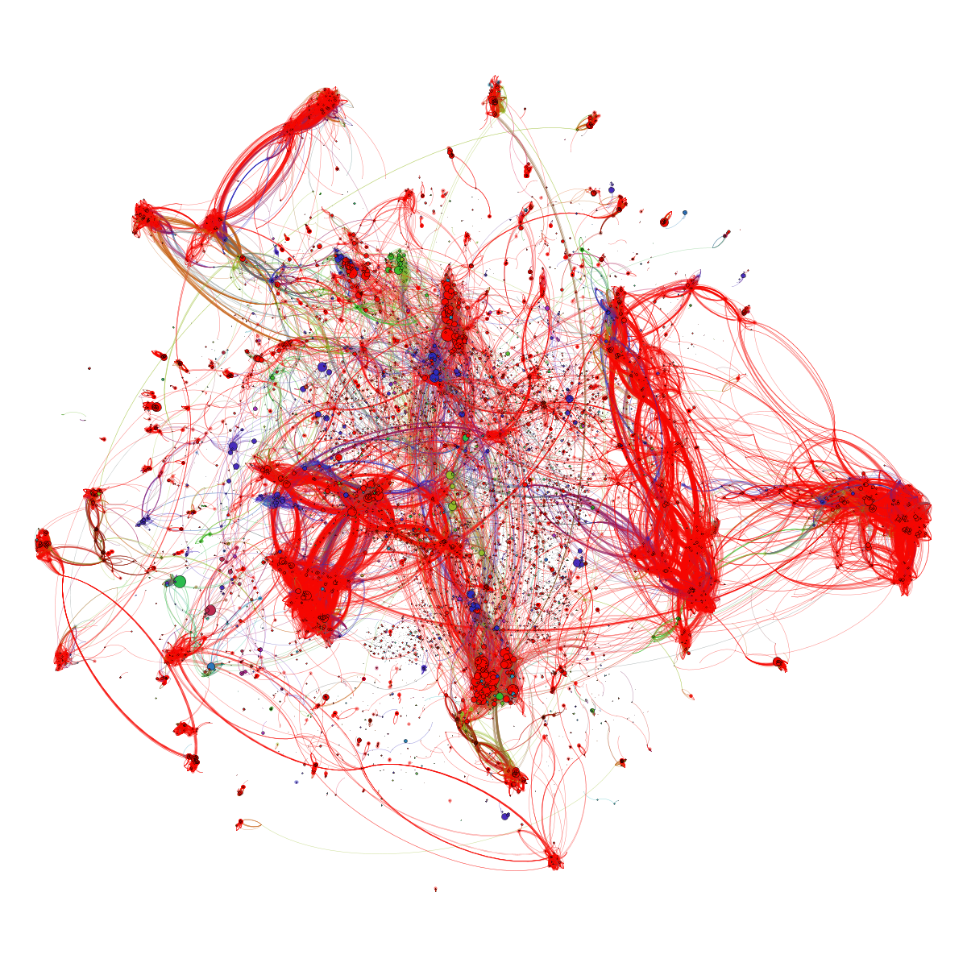
Notes:
3d anomaly detection

Slide 22
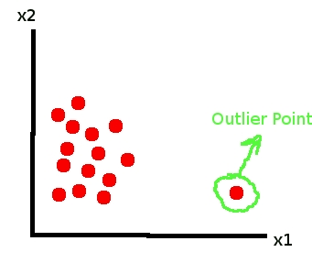
Anomaly Detection
Find fishy values and derive business integrity rules by scanning data

Slide 23

BOL - CQRS

Slide 24

Books Online - WebShop
Products
Webshop visits
searches
product details
Orders
Product updates
Read only
On line
Speed is crucial
XHTML & JSON
> 5M visits
Data manipulation
Data Quality (enforcement)
<10K transactions
Batch jobs next to online
Speed is nice
firewall

Slide 25


Nightly generation
DMZ
Webshop visits
searches
product details
Orders
Products
Products
Products
Products
Product updates
Read only
On line
Speed is crucial
XHTML & JSON
> 1M visits
Read only
JSON documents
Images
Text Search
Scale Horizontally
Stale but consistent
Data manipulation
Data Quality (enforcement)
<10K transactions
Batch jobs next to online
Speed is nice
firewall

Slide 26
Products
Data Manipulation
Data Retrieval

Slide 27
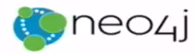



Products
Data Manipulation
Quick Product Search Index
Special Products
Data Retrieval
Toys
Product Clusters
Product Store in SaaS app
Food Stuff
Notes:
Data manipulation and retrieval in separate places
(physical data proliferation)
Query store is optimized for consumers
Level of detail, format, filters applied
For performance and scalability, independence, productivity lower license fees and lower TCO, security

Slide 28
Comand Query Responsbility Segregation = CQRS
Detect changes
Products
Extract Data
Data Manipulation
Transport Data
Convert Data
Special Products
Apply Data
Data Retrieval
Toys
Quick Product Search Index
Product Clusters
Food Stuff
Product Store in SaaS app
Notes:
No Event Sourcing
No events (?)
No green field
Packages Applications/SaaS
Databases (RDBMS, NoSQL) getting changes from applications directly
Challenges – at scale, with enough speed and consistently: do not let query store get into an exposed state that could not exist/be right!
Detect relevant changes
Extract relevant changes
Transport
Convert
Apply in correct order and reliably (no lost events)
Note: after detect and extract, an event can be published

Slide 29


From C to Q
How quickly?
How frequently?
How reliably?
How atomically?
Products
Quick Product Search Index

Slide 30


Slide 31
From C to Q
How quickly?
How frequently?
How reliably?
How atomic?
Data Authorization Considerations
Locations & Connectivity
Full resynch | restore of Query Store
Products
Quick Product Search Index

Slide 32

[let go of] The Holy Grail of Normalization
Normalize to prevent
data redundancy
discrepancies (split brain)
storage waste

Slide 33
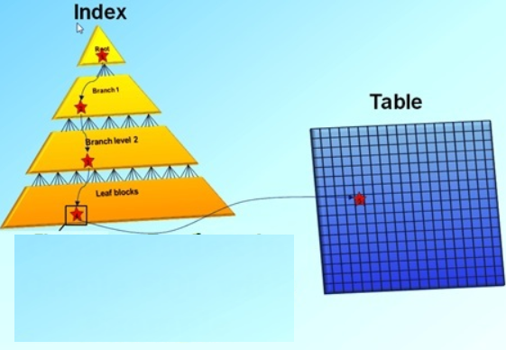
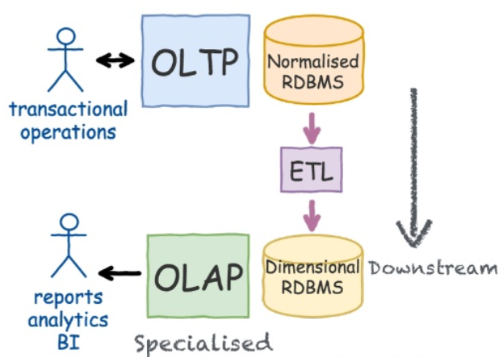
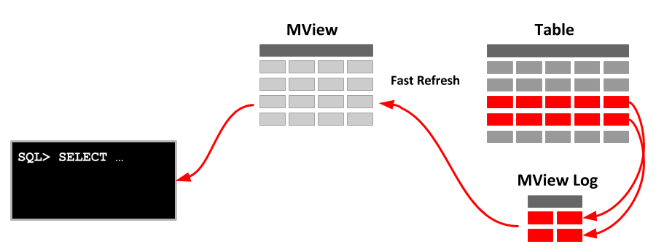
CQRS is not new
Notes:
https://www.slideshare.net/LorenzoNicora/from-c-to-q-one-event-at-the-time-event-sourcing-illustrated

Slide 34
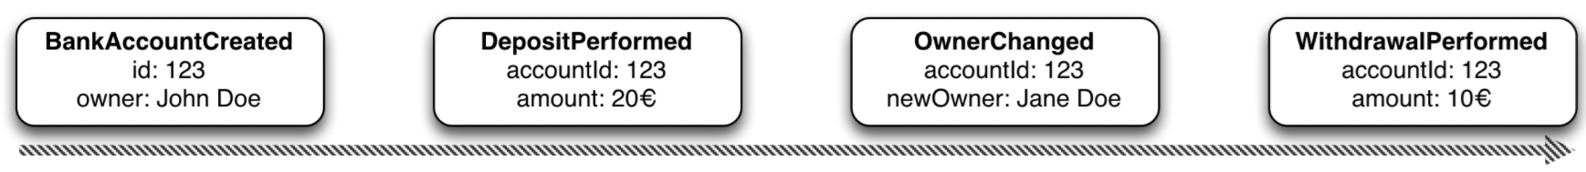
Event Sourcing Driving CQRS
amount: 10
Owner: Jane Doe
Events
Current State
Event Store
accountId: 123
Notes:
Events are immutable facts
Current state (active record) is derived from sum of events
Read optimized aggregates are created for specific use case – based on events and rebuildable at any time

Slide 35
Event Sourcing Driving CQRS
Events
Current State
Event Store
Other State Aggregate
Notes:
Events are immutable facts
Current state (active record) is derived from sum of events
Read optimized aggregates are created for specific use case – based on events and rebuildable at any time

Slide 36
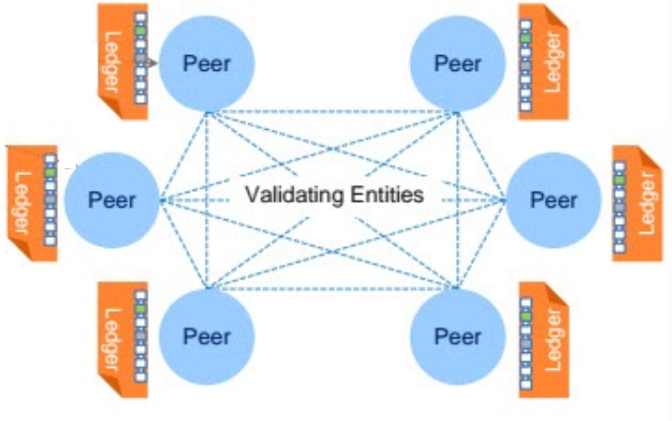





Distributed Database with Event Sourcing & Current State
Transaction
World State
Notes:
Blockchain!

Slide 37
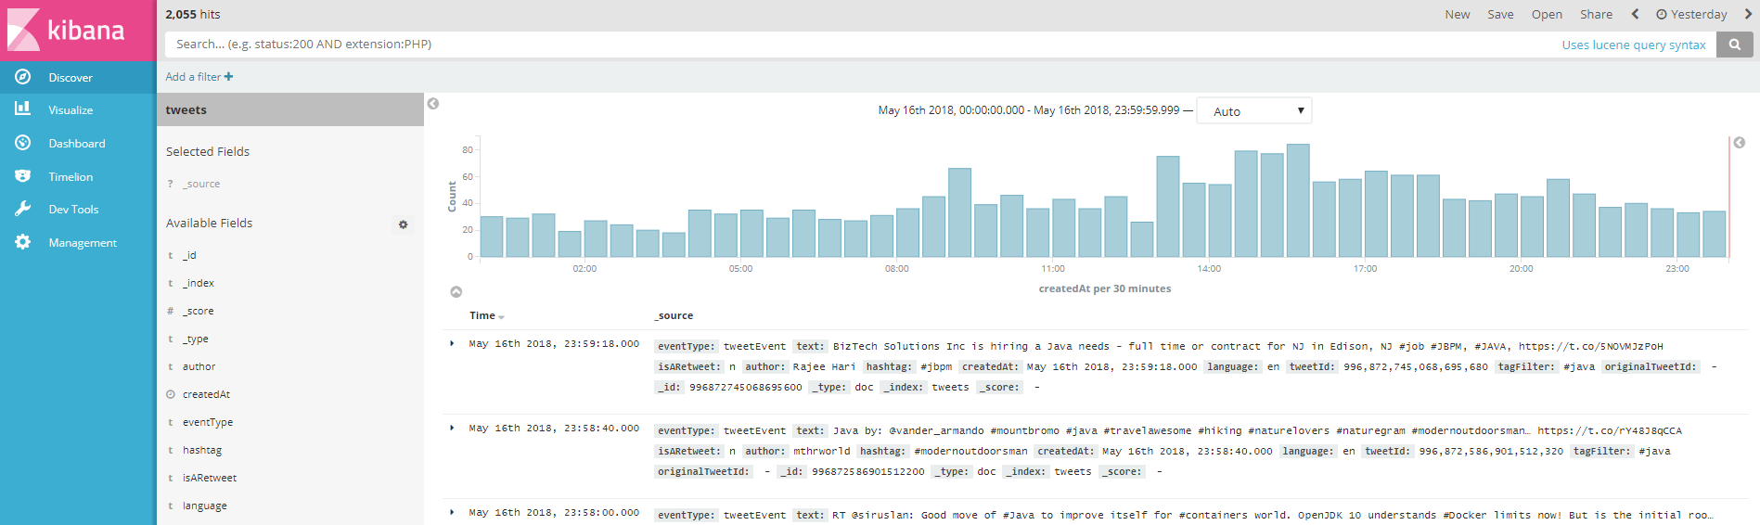

Oracle Cloud
Application Container
Event Hub
Tweets
Topic
Application Container
Container

Slide 38

SQL is not good at anything
But it sucks at nothing
Notes:
https://specify.io/concepts/microservices

Slide 39
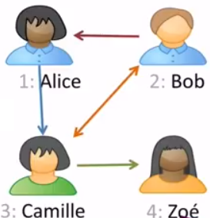
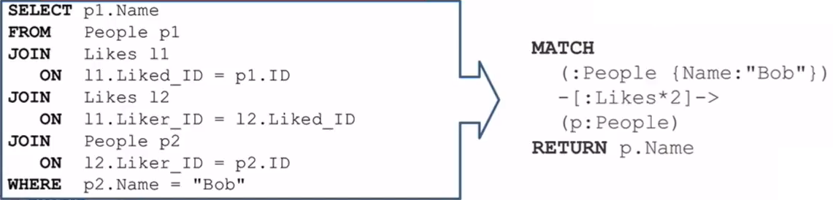
Graph Database
Natural fit during development
Superior (10-1000 times better) performance
Find People liked by anyone liked by Bob
Person liked by anyone liked by Bob
Find People liked by anyone liked by Bob
Notes:
https://specify.io/concepts/microservices

Slide 40
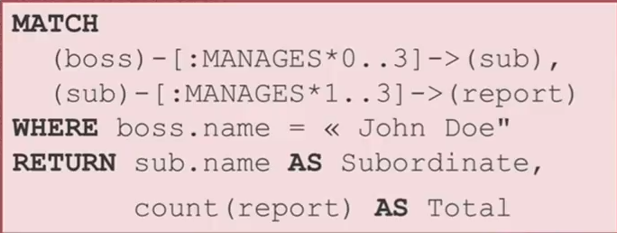
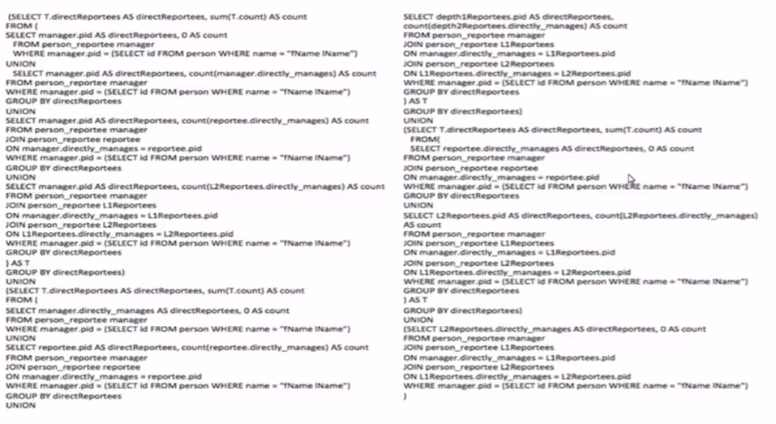
From relational SQL to Graph query
Notes:
https://specify.io/concepts/microservices

Slide 41
SQL vs NoSQL

Slide 42
SQL vs NoSQL ACID vs BASE Relational vs …

Slide 43
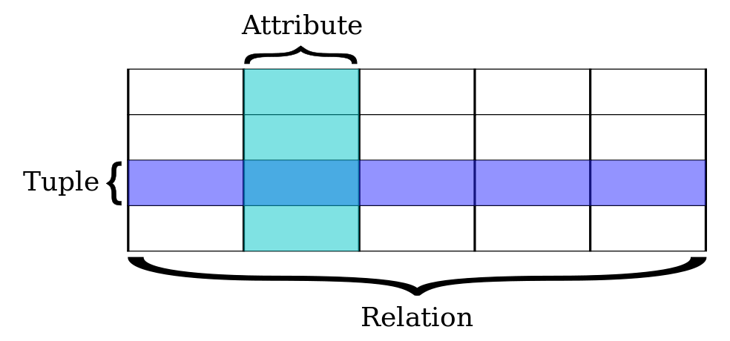
Relational Databases
Based on relational model of data (E.F. Codd), a mathematical foundation
Uses SQL for query, DML and DDL
Transactions are ACID (Atomicity, Consistency, Isolation, Durability)
All or nothing
Constraint Compliant
Individual experience [in a multi-session environment] (aka concurrency)
Down does not hurt
Notes:
https://specify.io/concepts/microservices

Slide 44
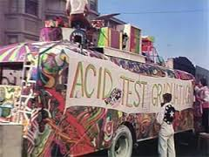
ACID comes at a cost – performance & scalability
Transaction results have to be persisted [before the transaction completes] in order to guarantee D
Concurrency requires some degree of locking (and multi-versioning) in order to have I
Constraint compliance (unique key, foreign key) means all data hangs together (as do all transactions) in order to have C
Two-phase commit (across multiple participants) introduces complexity, dependencies and delays, yet required for A
Notes:
https://specify.io/concepts/microservices

Slide 45

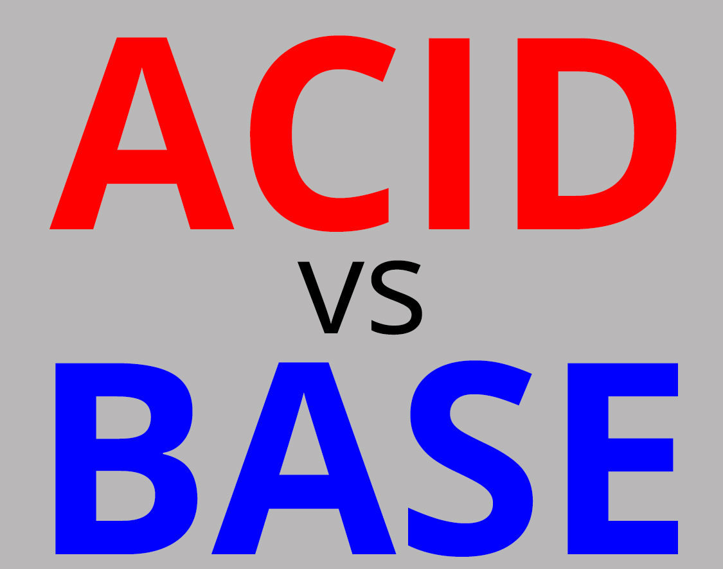



Notes:
WebScale
‘No ACID
BASE
Speed, reads
Redundancy
Read-optimized format
Not all use cases require ACID (or can afford it)
Read only (product catalog for web shops)
Inserts only and no (inter-record) constraints
Big Data collected and “dumped” in Data Lake (Hadoop) for subsequent processing
High performance demands
Not all data needs structured formats or structured querying and JOINs
Entire documents are stored and retrieved based on a single key
Sometimes – scalable availability and developer productivity is more important than Consistency – and ACID is sacrificed
CAP-theorem states: Consistency [across nodes], Availability and Partition tolerance can not all three be satisfied

Slide 46


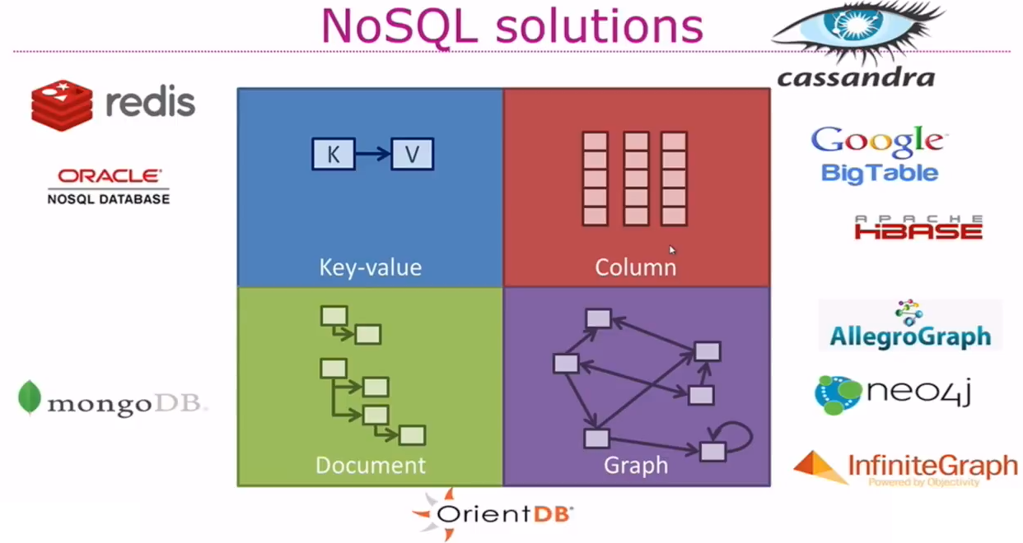


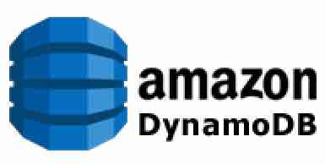




Types of NoSQL
Notes:
https://specify.io/concepts/microservices

Slide 47
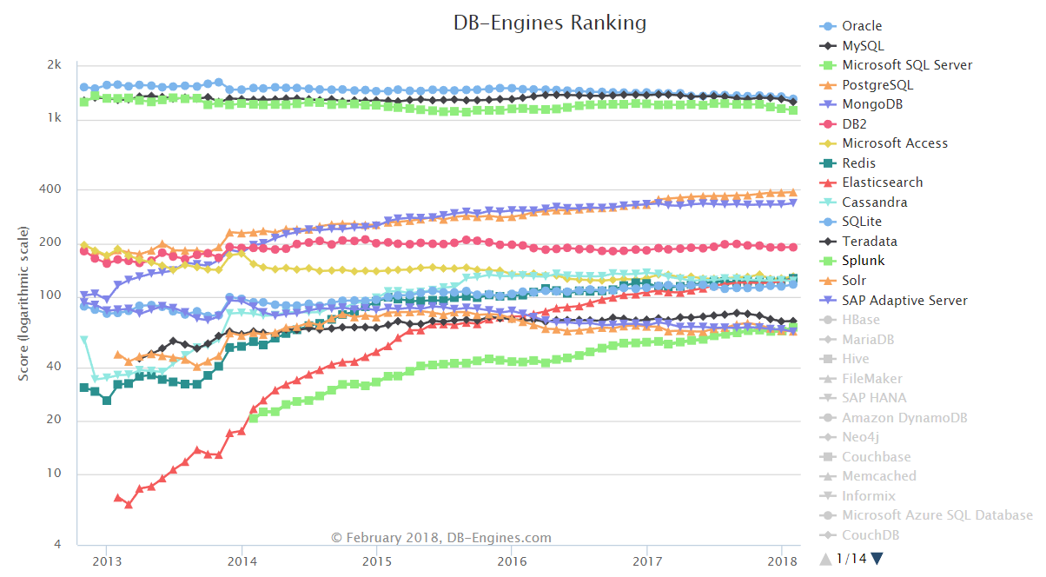
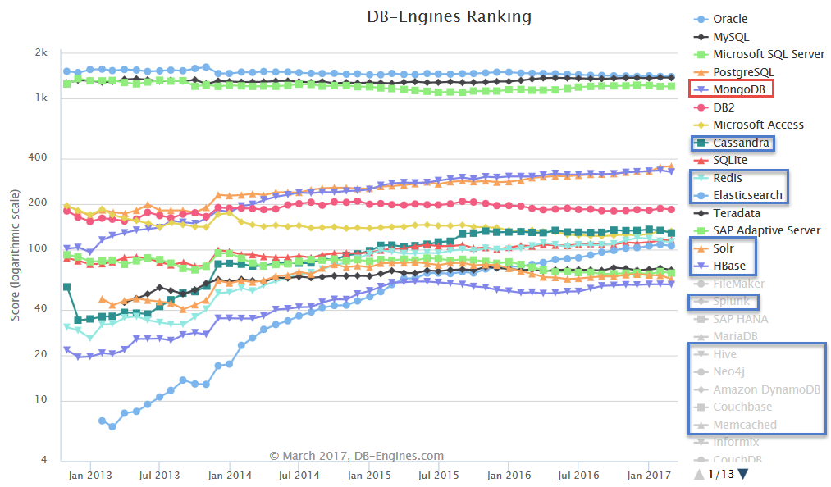
(leading) NoSQL Database products
MongoDB is (one of) the most popular (by any measure)
Elastic Search and Cassandra are close contenders
Cloud (only):
Google BigTable,
AWS Dynamo
Cache (in memory)
ZooKeeper, Redis, Coherence, Memcached, Apache Ignite (pka GridGain), …
Hadoop/HDFS
Oracle NoSQL (fka Berkeley DB)
Notes:
https://specify.io/concepts/microservices

Slide 48


Slide 49

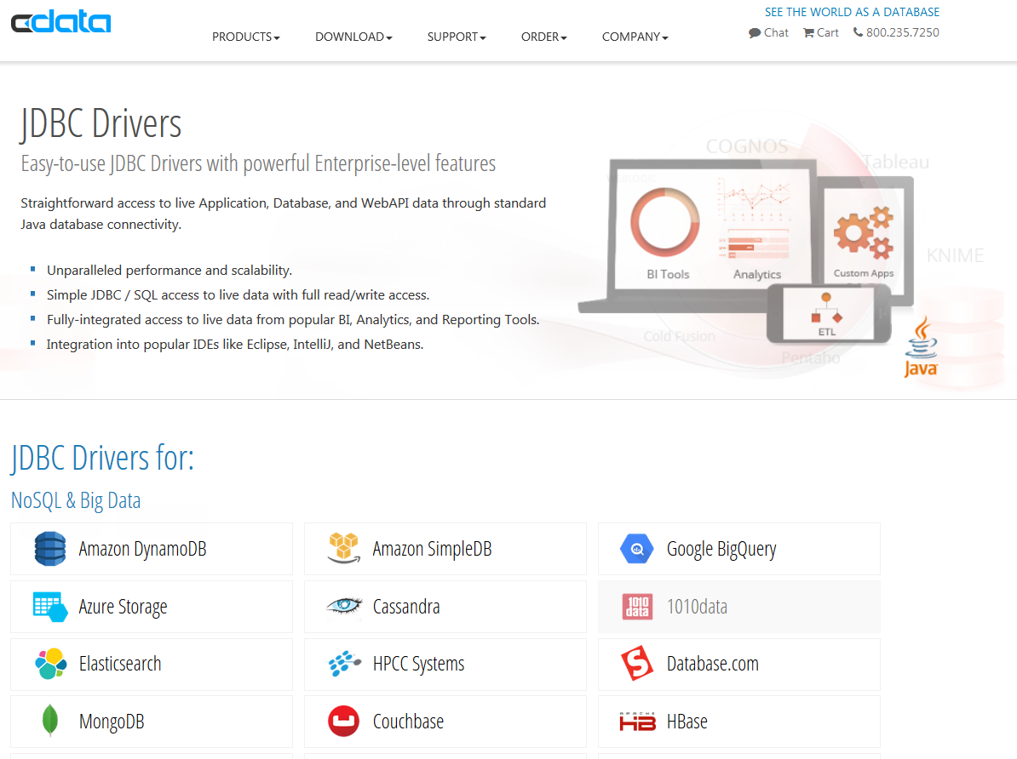

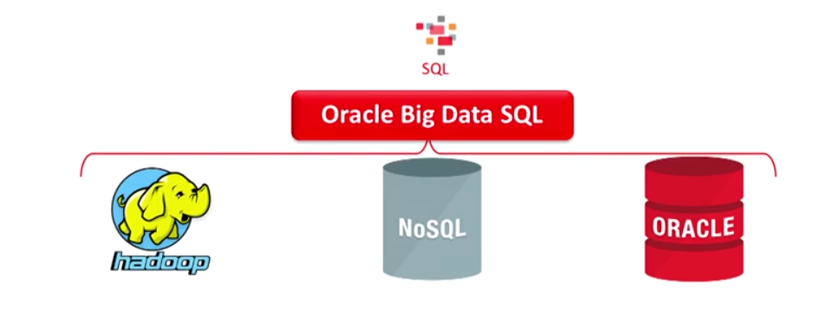
NoSQL n’est pas No SQL

Slide 50


Slide 51
When things were simple
RDBMS
SQL
ACID
SAN
Backup
Data files
Log Files
Backup
Backup

Slide 52
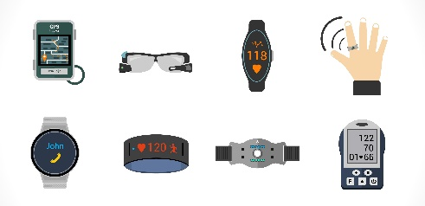
And then stuff happened
Mobile App (offline)
Client Tier: Browser
Mobile App (offline)
Client Tier: Browser
Mobile App (offline)
API
Client Tier: Browser
API
API
µ
λ
Middle Tier:
Java EE (Stateful) application
Fast Data
OO, XML, JSON
Data Warehouse
Content Management
Big Data

Slide 53




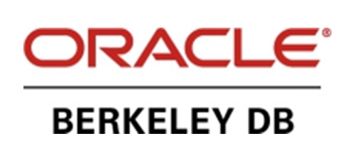

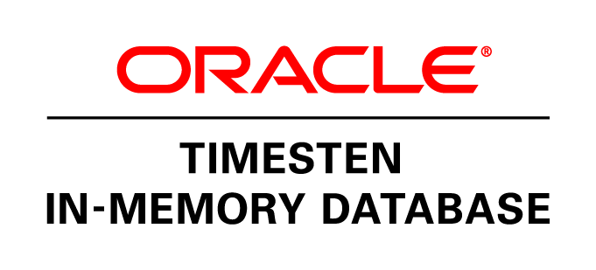






Slide 54
Oracle Database
SQL
RDBMS
ACID

Slide 55
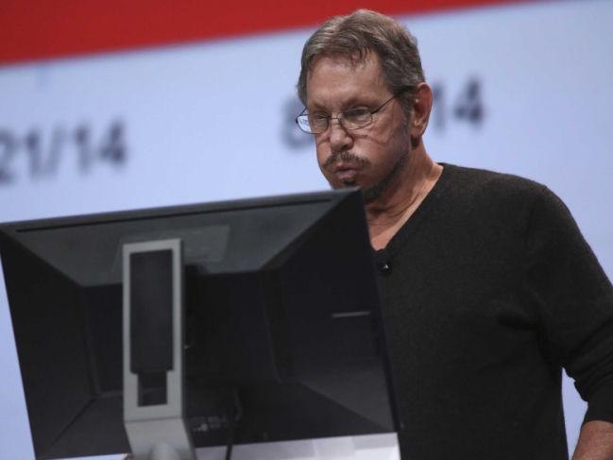
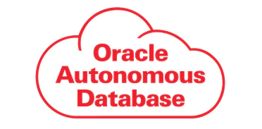

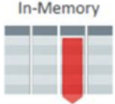

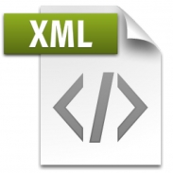


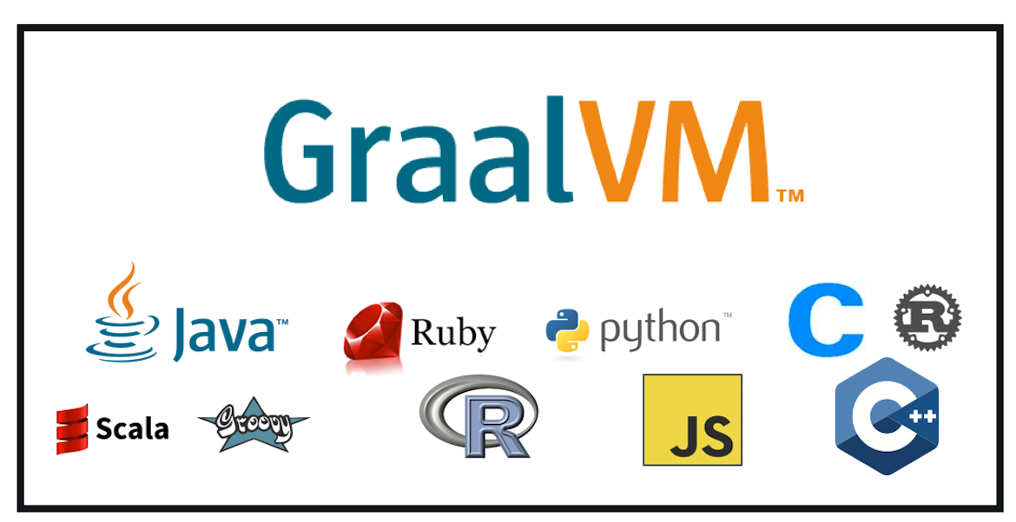
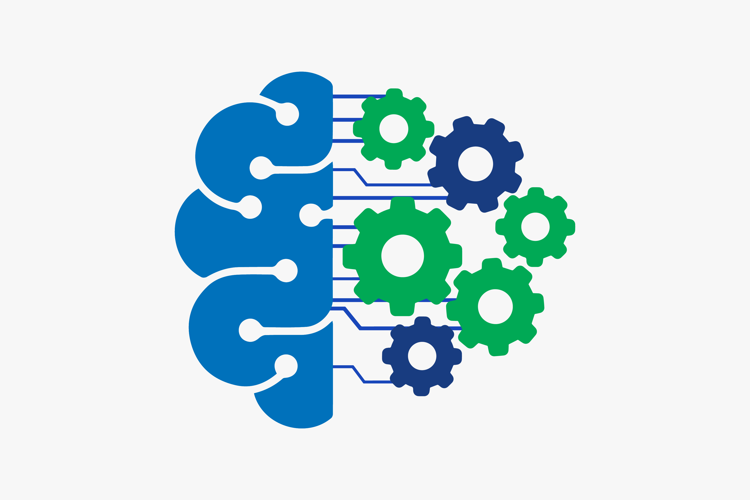
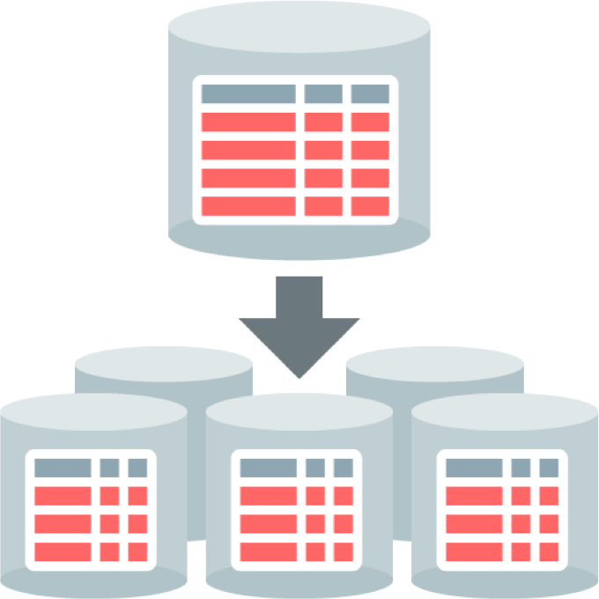



http
http
IoT Fast Data Ingestion
Flashback
Machine Learning
Big Data SQL
Sharding
No SQL
Multitenant (Pluggable Database) Architecture

Slide 56
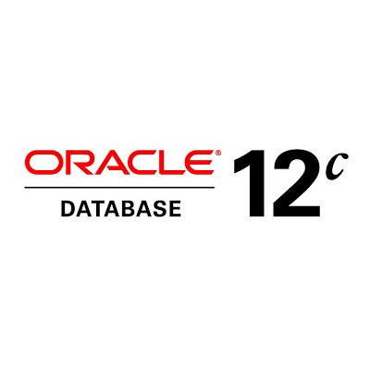
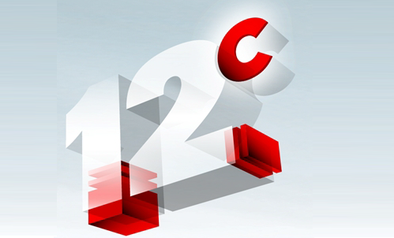

Slide 57
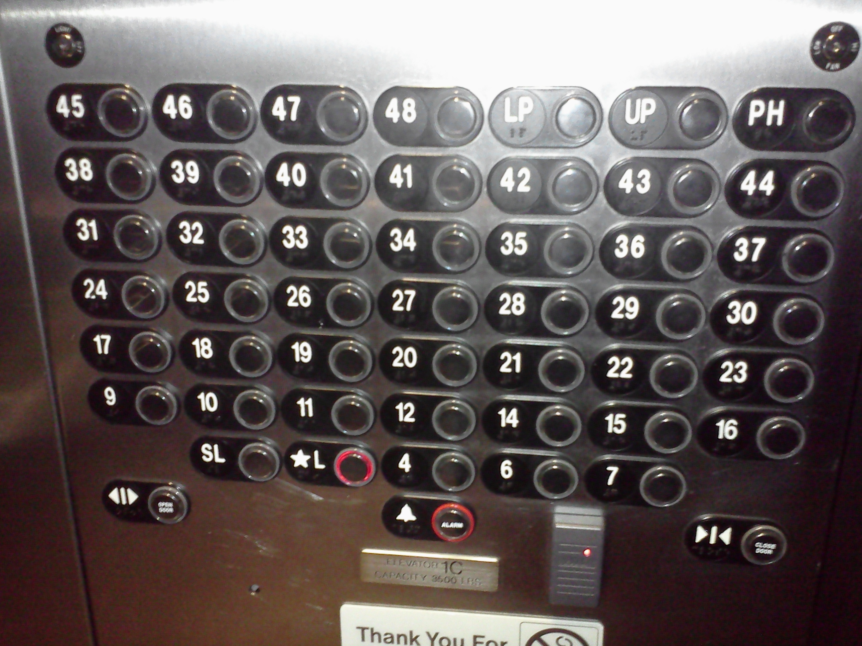



Slide 58



Slide 59
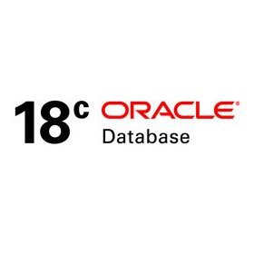


Slide 60
http
http
IoT Fast Data Ingestion
Flashback
Machine Learning
Big Data SQL
Sharding
No SQL
Multitenant (Pluggable Database) Architecture

Slide 61



Slide 62



Oracle Database XE – eXpress Edition
Current version: XE 11gR2
Coming in October 2018: XE 18c, with yearly releases (19c, 20c, …)
All functionality of single instance Oracle Database Enterprise Edition plus Extra Options
(including R, Machine Learning, Spatial, Compression, Multi Tenant, Partitioning)
Code and Data Compatible with other editions – including plug/unplug
Resource Limitations for 18c:
2 CPUs
2 GB of memory
12 GB of disk space (using Compression effectively 40 GB of data)
No patches or support

Slide 63
http
http
IoT Fast Data Ingestion
Event Sourcing
Machine Learning
Big Data SQL
Sharding
No SQL
Multitenant (Pluggable Database) Architecture

Slide 64

Time Machine

Slide 65


Query all versions | past states | change events of a record

Slide 66

Turn Transaction History into Events
http
Products

Slide 67


Event Sourcing from Database Transaction Log
Product Modified Event
DBaaS
Pro ducts
History
http
DML
Products
Topic
generate
events
Notes:
Reconstruct DML Events
Reconstruct History
Reverse Engineering of Event Source
DEMO Flashback Query & Flasback Versions Query
Publish Events from Database using HTTP (or Stored Java)
QCRN, Trigger + Job, Log Mining, Scheduled Flashback Job,

Slide 68

Final Demo
Microservices
Microservice

Slide 69

Microservices
Agile | Flexible | Scalable | (Re)Deployable
Independent | Decoupled | Isolated
Communicate asynchronously, via events
Have their own private bounded context – the data they require to function
Their lifeblood

Slide 70
Microservices State
Generic Platform for running microservices
LDAP
Big Data
Block Storage
Cache
RDBMS
NoSQL
Document Store
Event Hub
Notes:
All data stores are distributed
Or at least distributedly available
They can be local or on cloud (latency is important)
Data in generic data store is still owned by only one microservice – no one can touch it
Only in DWH and BigData do we deliberately take copies of data and disown them

Slide 71
Bounded context of microservices
A micoservice needs to be able to run independently
It needs to contain & own all data required to run
It cannot depend on other microservices
UI
API
Customer
API
Order
CustomerModified event

Slide 72


Demo – Maintaining Derived Data in Bounded Context
Customer Microservice
Order Microservice
Customer Modified Event
Application Container
Application Container
Event Hub
Customers
Topic
DBaaS

Slide 73
Wrap Up

Slide 74


Slide 75












Notes:
Data used to be like T-Ford
One model, one color
And then:

Slide 76

location
Total Cost of Data Ownership
query patterns
usage
volume
volatility
format
distribution
required consistency
freshness requirements (staleness allowance)
integrity
speed
authorization
ACID demands
ownership
availability
Notes:
Data comes in many shades (at least 50) – variations along many dimensions

Slide 77





Slide 78
Summary
Multiple types of data
Stored and processed in different ways
Same data sometimes used in multiple, different ways
Stored and processed multiple times – optimized for each use case
The meaning of some terms cannot be taken too literally
Real Time and Fresh
Integrity and Truth
Consistency and transactions
Understand your data
Meta: What does it mean?
Master: Where is the source?

Slide 79






Slide 80


Notes:
technologies

Slide 81
Wrap Up
DATA
DATA
DATA
DATA
DATA
DATA
DATA
DATA

Slide 82





Thank you Dank je wel
Blog: technology.amis.nl
Email: lucas.jellema@amis.nl
: @lucasjellema
: lucas-jellema
: www.amis.nl, info@amis.nl
https://github.com/lucasjellema

